Slide 1
DATA SCIENCE
11 WEEK PART TIME COURSE
Week 10 - Network Analysis
Monday 23rd May 2016

Slide 2
AGENDA
Tasks from Wednesday
Network Analysis
Lab
Discussion

Slide 3
WHAT IS NETWORK ANALYSIS?
DATA SCIENCE PART TIME COURSE

Slide 4
WHAT IS A NETWORK?

Slide 5
WHAT IS A NETWORK?
Many types of real-world problems involve dependencies between observations.
For example:
Town planners are looking at vehicular flows through a city
Sociologist want to understand how people influence others that they know (if at all)
Biologists want to know how proteins regulate the actions of other proteins
Information agencies want to discover groups of adversaries

Slide 6
WHAT IS A NETWORK?
Problems involving dependencies can often be modelled as graphs, and scientists have developed methods for answering these questions called network analysis.

Slide 7
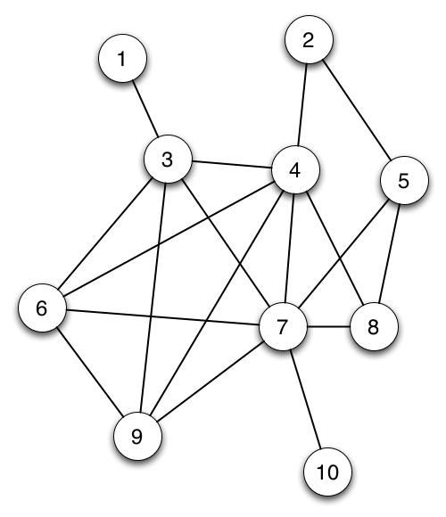
WHAT IS A GRAPH?
A graph consists of a nodes (or vertices) and are connected by edges.
For example the nodes may represent people and the edges are there if a friendship exists.
How many nodes and edges are there?

Slide 8
WHAT IS A GRAPH?
Nodes = 10
Edges = 18

Slide 9
WHAT ARE THE METRICS OF A GRAPH?
How do we know who the key actors (nodes) are in our network ?
We need to calculate some measures of importance (or centrality).
What are some of the ways you might measure an individual’s centrality (there are multiple measures).

Slide 11
WHAT ARE THE METRICS OF A GRAPH?
Degree Centrality - number of edges a node has
Closeness Centrality - the reciprocal of the sum of the shortest path distances from one node to all n-1 other nodes. Since the sum of distances depends on the number of nodes in the graph, closeness is normalized by the sum of minimum possible distances n-1. Higher values of closeness indicate higher centrality
Betweenness Centrality - the sum of the fraction of all-pairs shortest paths that pass through the node v
Eigenvector centrality - computes the centrality for a node based on the centrality of its neighbours
Page Rank - count the number and quality of links to a page to determine a rough estimate of how important the website is. The underlying assumption is that more important websites are likely to receive more links from other websites

Slide 12
HOW DO WE CALCULATE THE METRICS OF A GRAPH?
NetworkX
Tool to study the structure and dynamics of social, biological, and infrastructure networks
Ease-of-use and rapid development
Open-source tool base that can easily grow in a multidisciplinary environment with non-expert users and developers
An easy interface to existing code bases written in C, C++, and FORTRAN
To painlessly slurp in relatively large nonstandard data sets

Slide 13
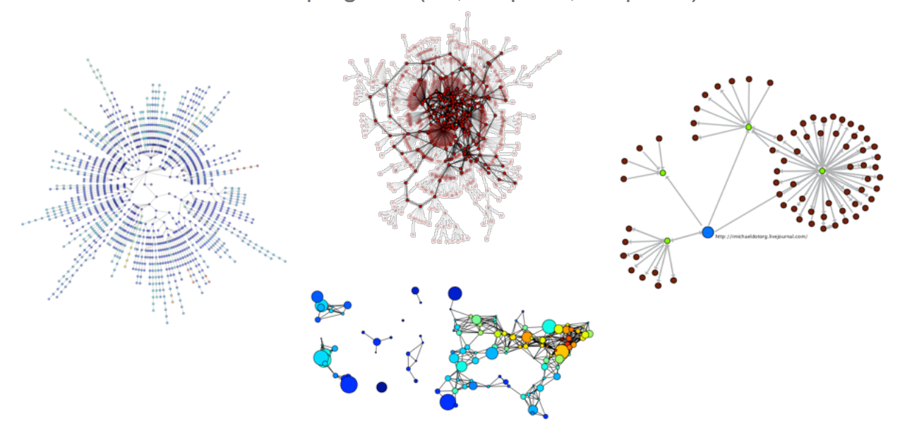
HOW DO WE VISUALISE A GRAPH?

Slide 14
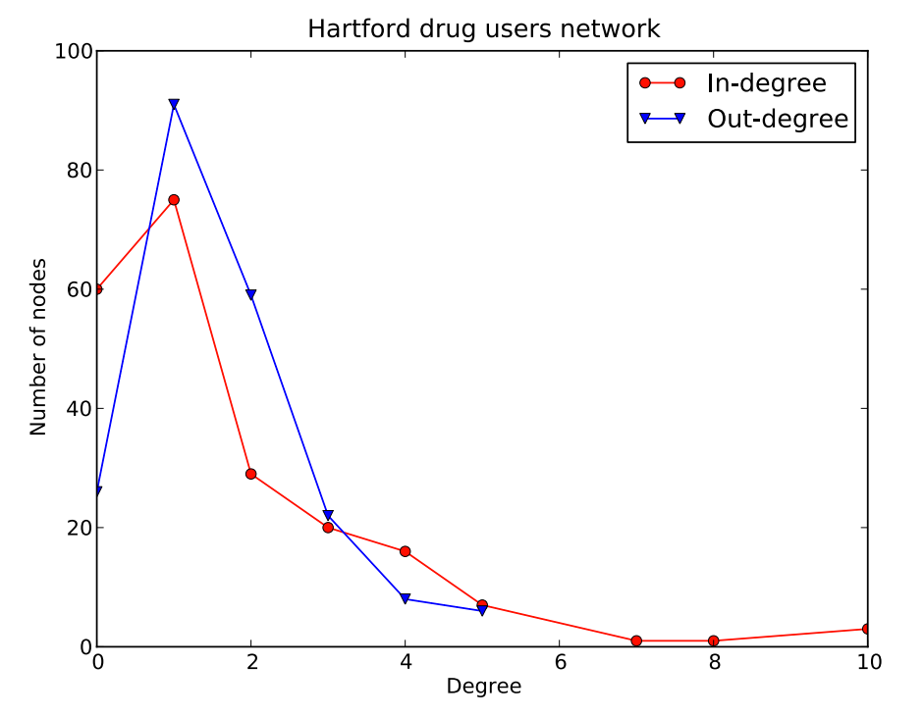
HOW DO WE VISUALISE A GRAPH?

Slide 15
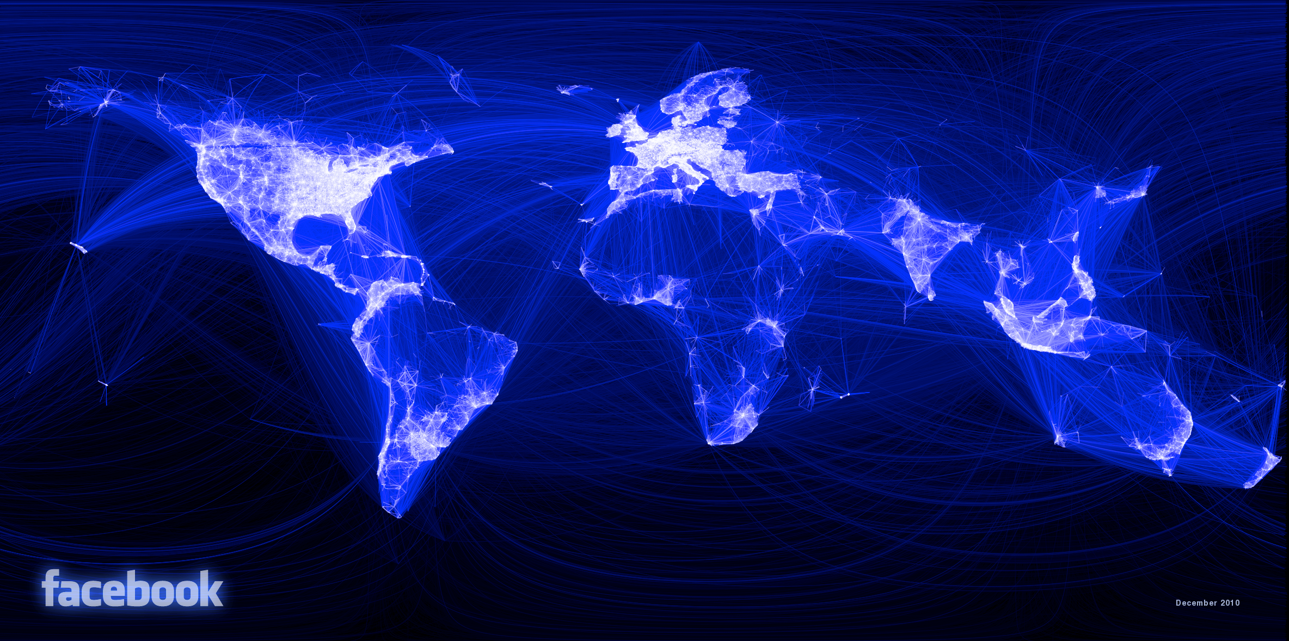
HOW DO WE VISUALISE A GRAPH?

Slide 16
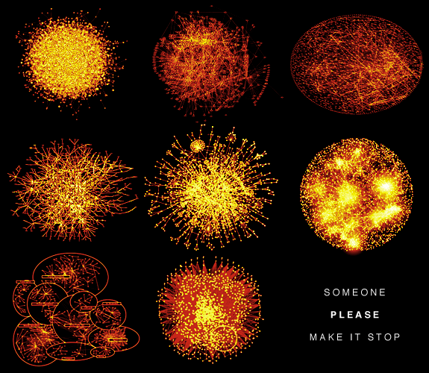
HOW DO WE VISUALISE A GRAPH?

Slide 17
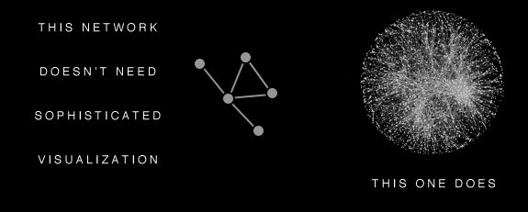
HOW DO WE VISUALISE A GRAPH?

Slide 18
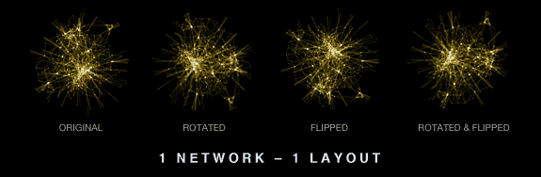
HOW DO WE VISUALISE A GRAPH?

Slide 19
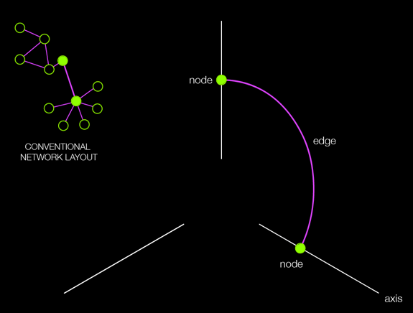
HOW DO WE VISUALISE A GRAPH?

Slide 20
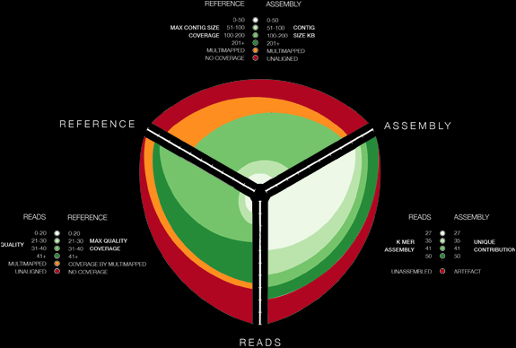
HOW DO WE VISUALISE A GRAPH?

Slide 21
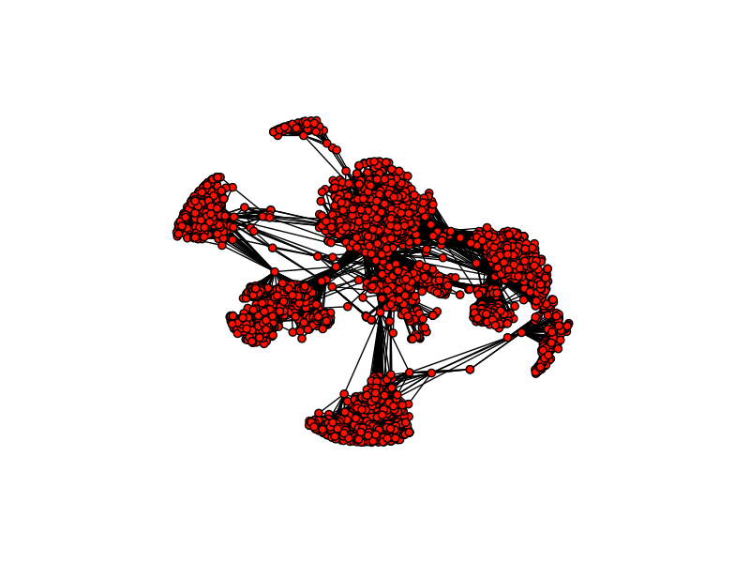
HOW CAN WE FIND COMMUNITIES?

Slide 22
HOW CAN WE FIND COMMUNITIES?
We all know on our Facebook page we have friends we made at different places and stages in our lives. We might have some work friends, school friends, some friends we made travelling, etc…
How might we find good groupings of communities?

Slide 23
HOW CAN WE FIND COMMUNITIES?
The criteria for finding good communities is similar to that for finding good clusters.
We want to maximize intra-community edges while minimizing inter-community edges.
Formally, the algorithm tries to maximize the modularity of network, or the fraction of edges that fall within the community minus the expected fraction of edges if the edges were distributed by random. Good communities should have a high number of intra-community edges, so by maximizing the modularity, we detect dense communities that have a high fraction of intra-community edges.

Slide 24
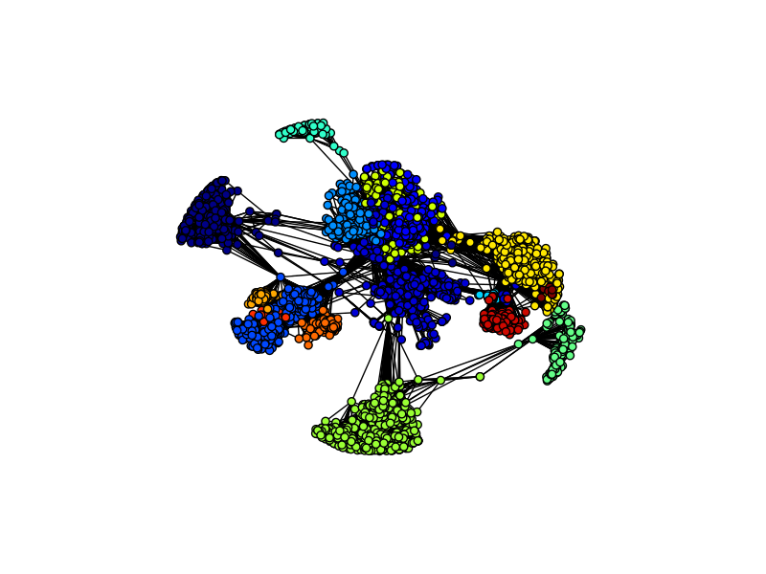
HOW CAN WE FIND COMMUNITIES?

Slide 25

CASE STUDY
BONAFIDE
DATA SCIENCE PART TIME COURSE

Slide 26
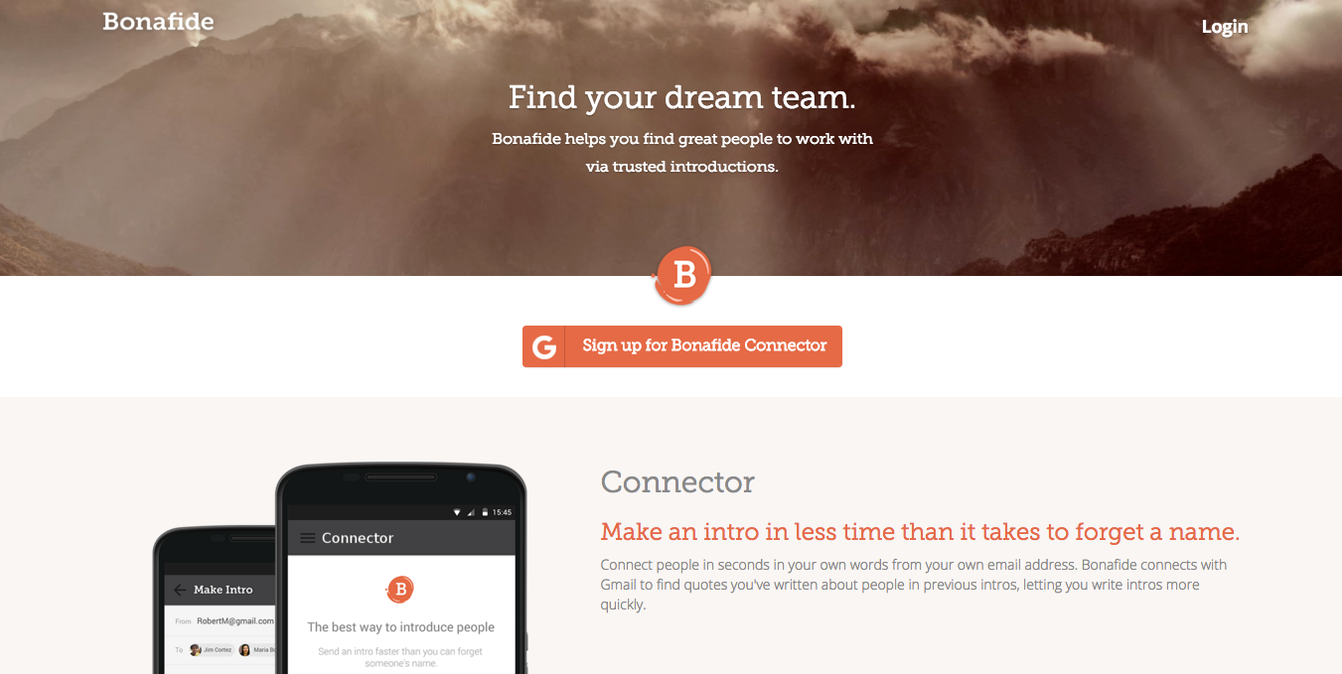

Slide 27
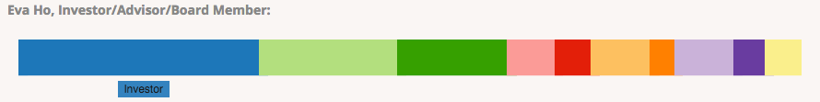
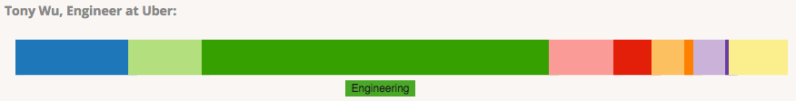
CASE STUDY - BONAFIDE

Slide 28
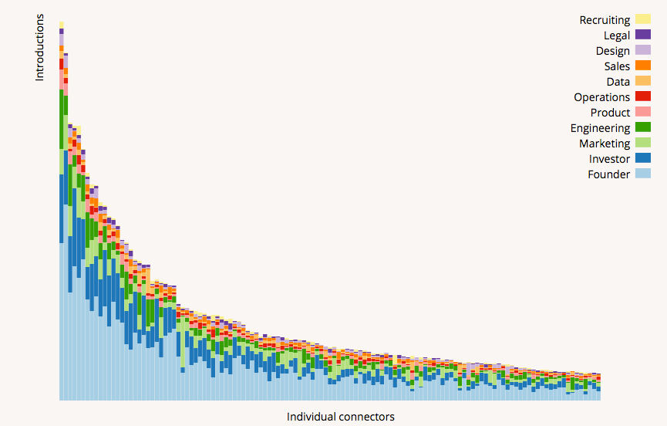
CASE STUDY - BONAFIDE

Slide 29
CASE STUDY - BONAFIDE
Two things stand out from the figure:
A lot of people introduce founders
Heavy connectors disproportionately introduce investors
https://bonafide.co/blog/which-professions-top-connectors-introduce

Slide 30
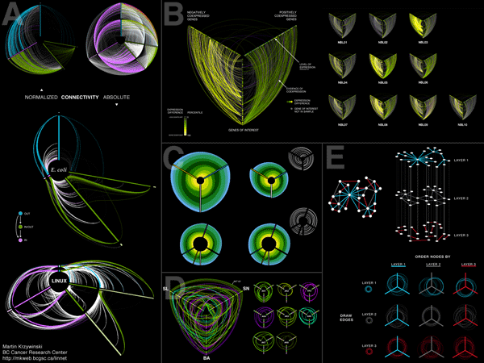
LAB
DATA SCIENCE PART TIME COURSE

Slide 31
REVIEW
Review
Tasks
Review
DATA SCIENCE - Week 10 Day 1

Slide 32
DISCUSSION TIME
Course
How’s it going?
Anything in particular during the past weeks that was challenging?
How has the pace been?
Anything you’d like to review next week?
DATA SCIENCE - Week 10 Day 1

Slide 33
Task List
Try running the Spark cluster (or ec2 instance)
Read the following articles:
http://www.wired.com/2016/01/googles-go-victory-is-just-a-glimpse-of-how-powerful-ai-will-be/
http://www.wired.com/2014/01/geoffrey-hinton-deep-learning
https://sites.google.com/site/deepernn/home/blog/briefsummaryofthepaneldiscussionatdlworkshopicml2015
Install TensorFlow
DATA SCIENCE - Week 10 Day 1

Slide 34
Task List
EMAIL ONE OF THE GUEST PRESENTERS OF THIS CLASS
DATA SCIENCE - Week 10 Day 2

Slide 35


Slide 36
WELL DONE EVERYONE !!
DATA SCIENCE - Week 10 Day 1

